Slide 1
以深度學習實現手語辨識
報告人:王樸、吳承威

Slide 2
目錄
已完成事項
以YOLO進行0-9之手語辨識
以LSTM進行UCF101動作辨識
未來規劃

Slide 3
YOLO

Slide 4
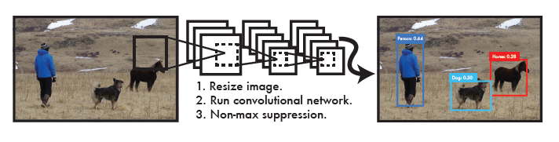
YOLO是什麼?

Slide 5
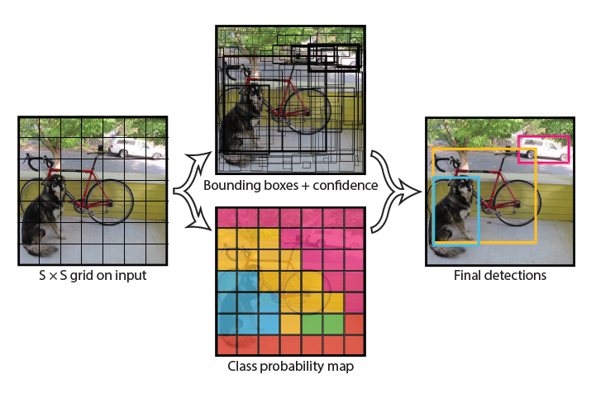

Slide 6
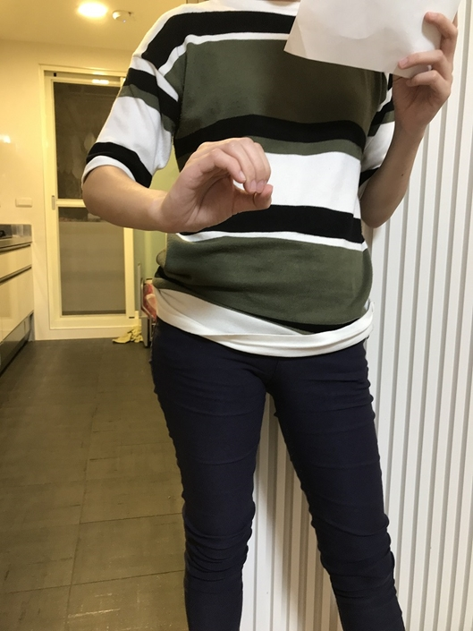
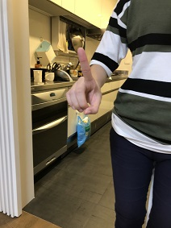
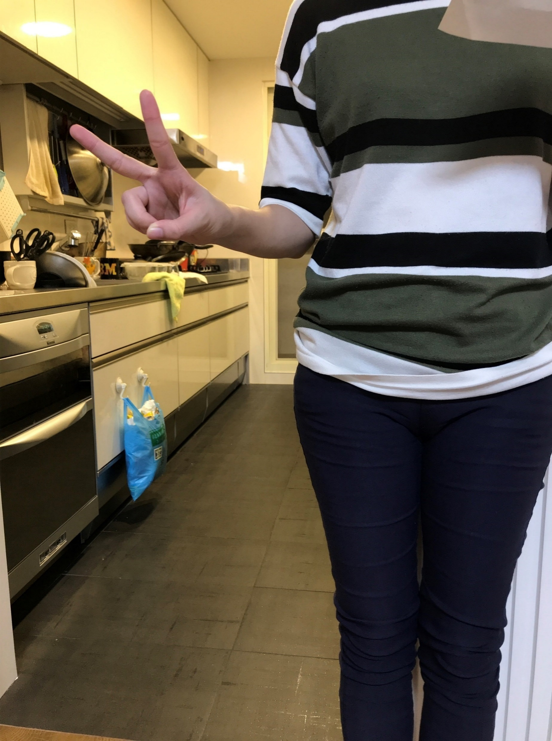
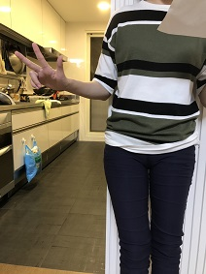
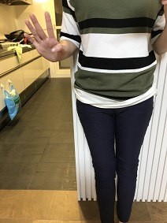
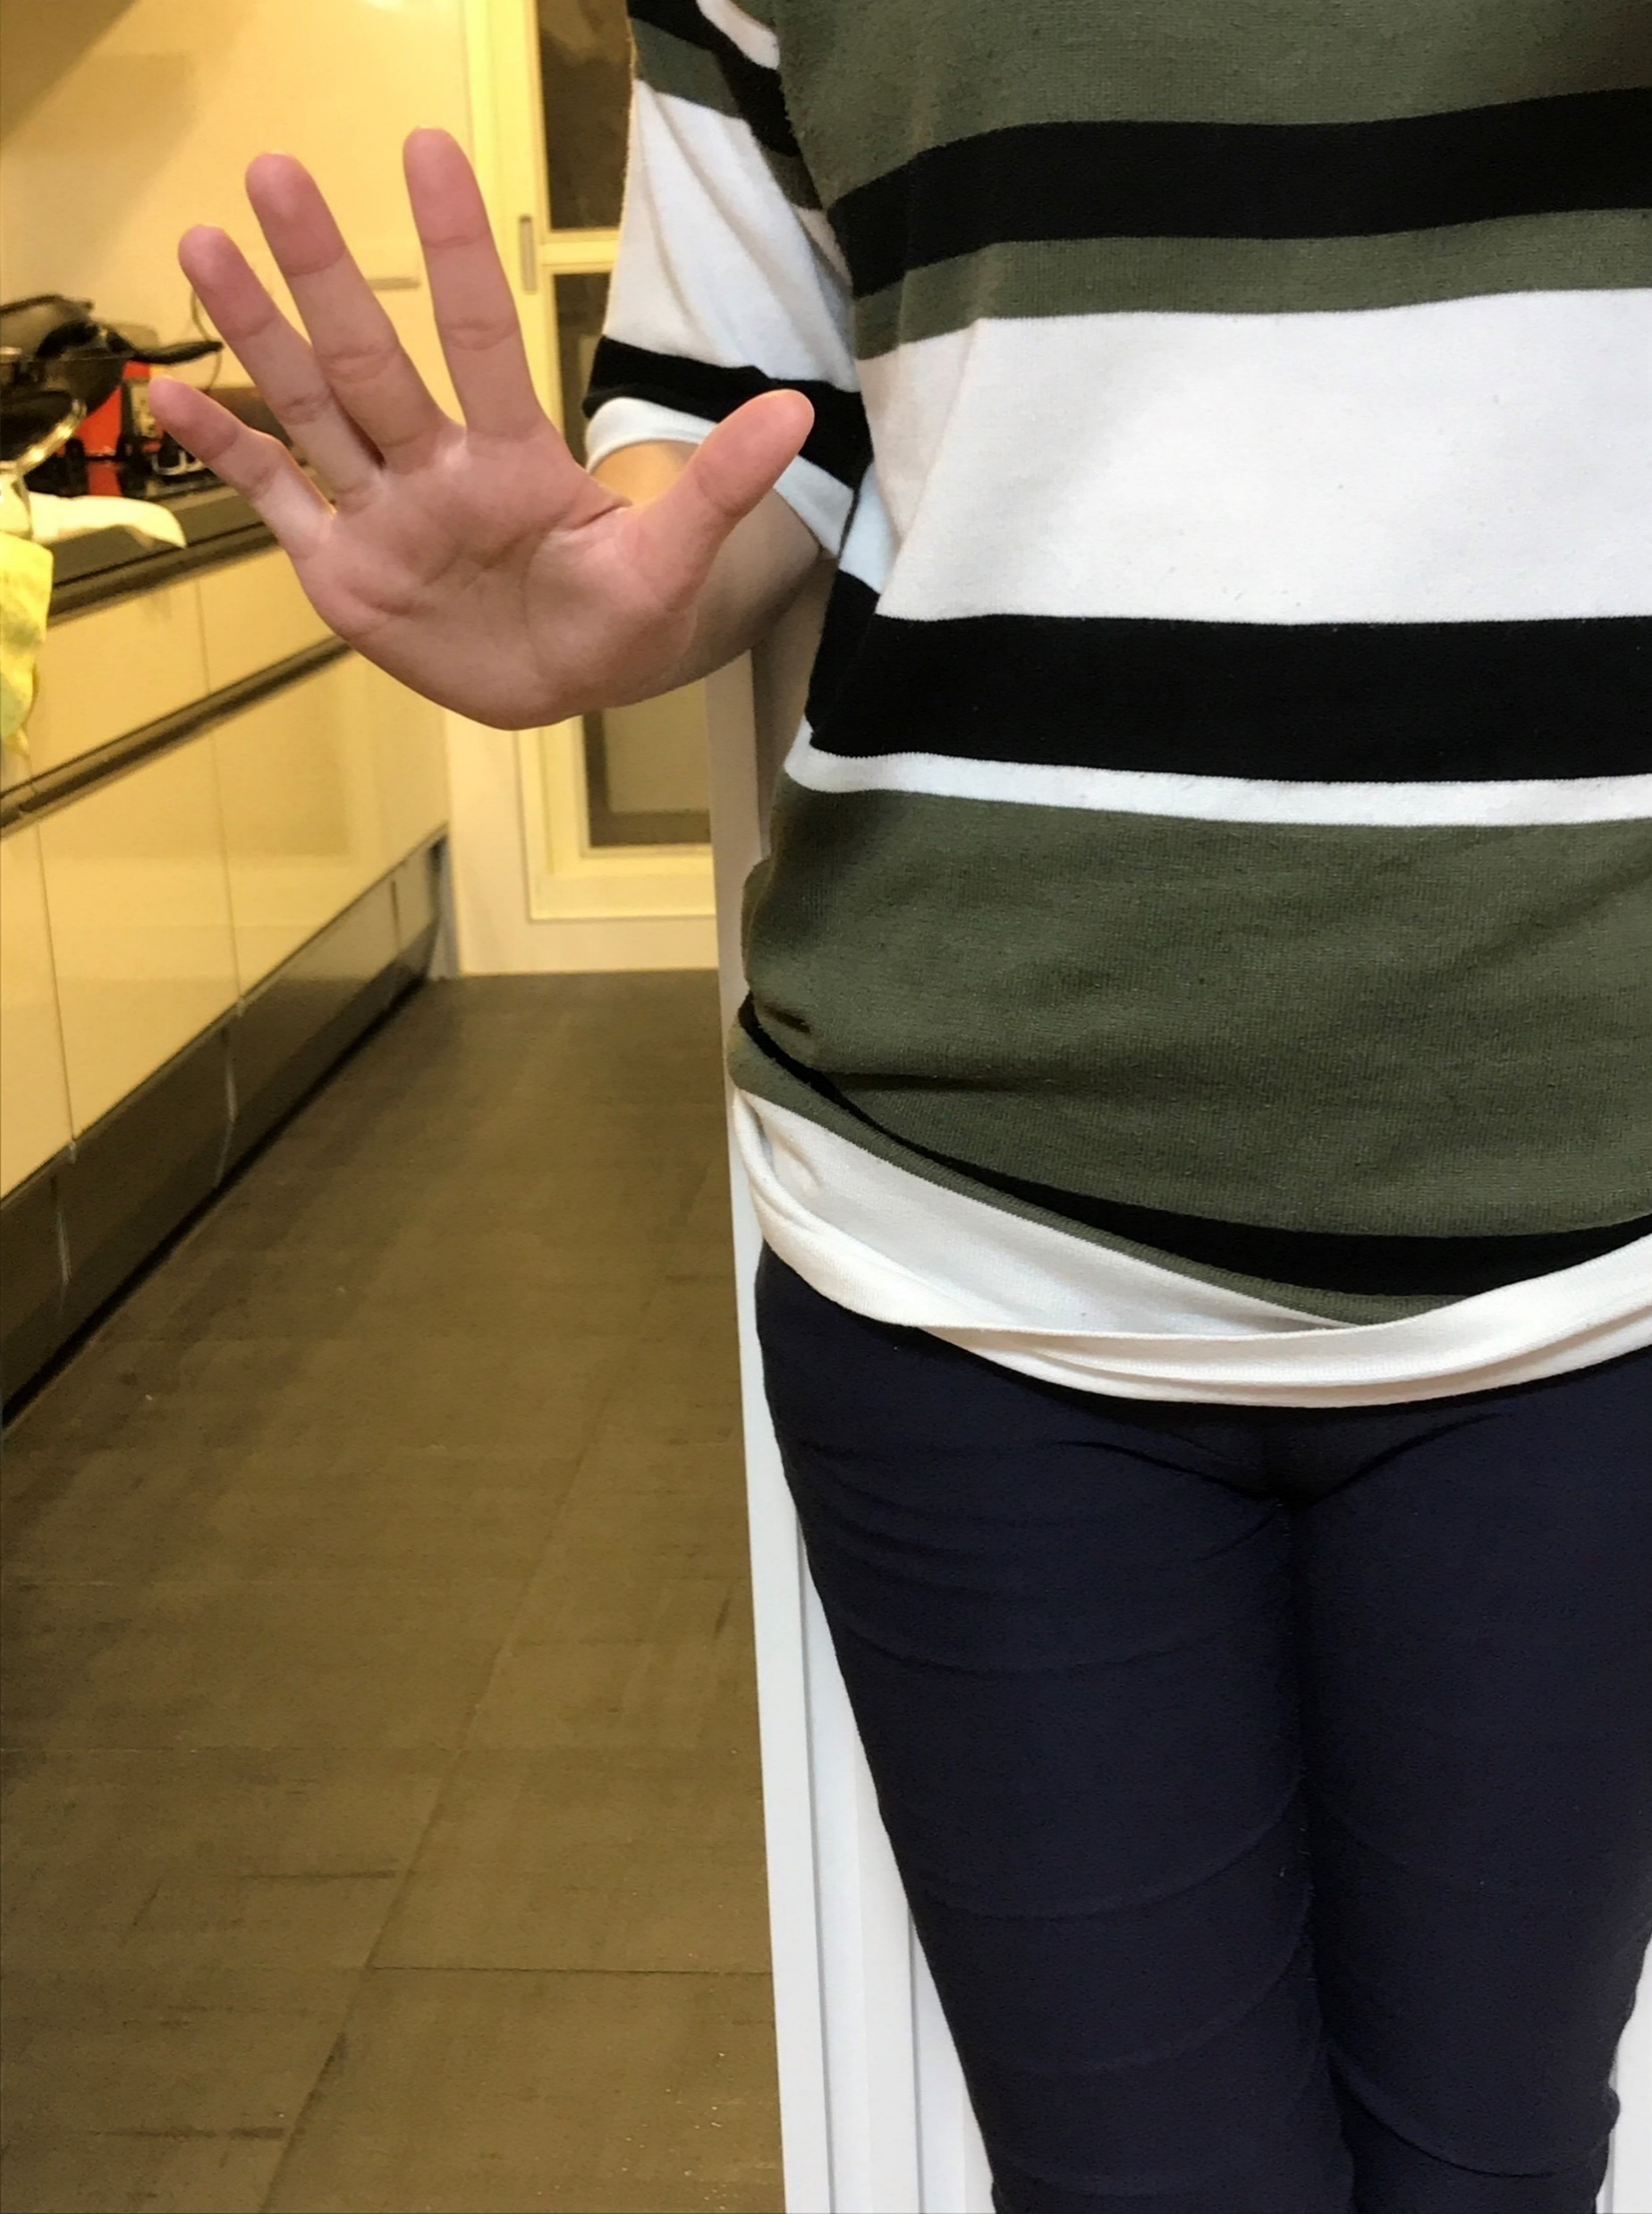
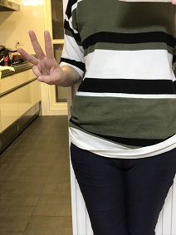
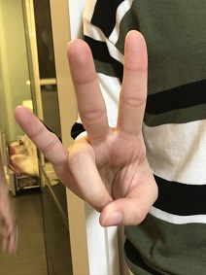
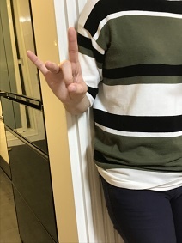
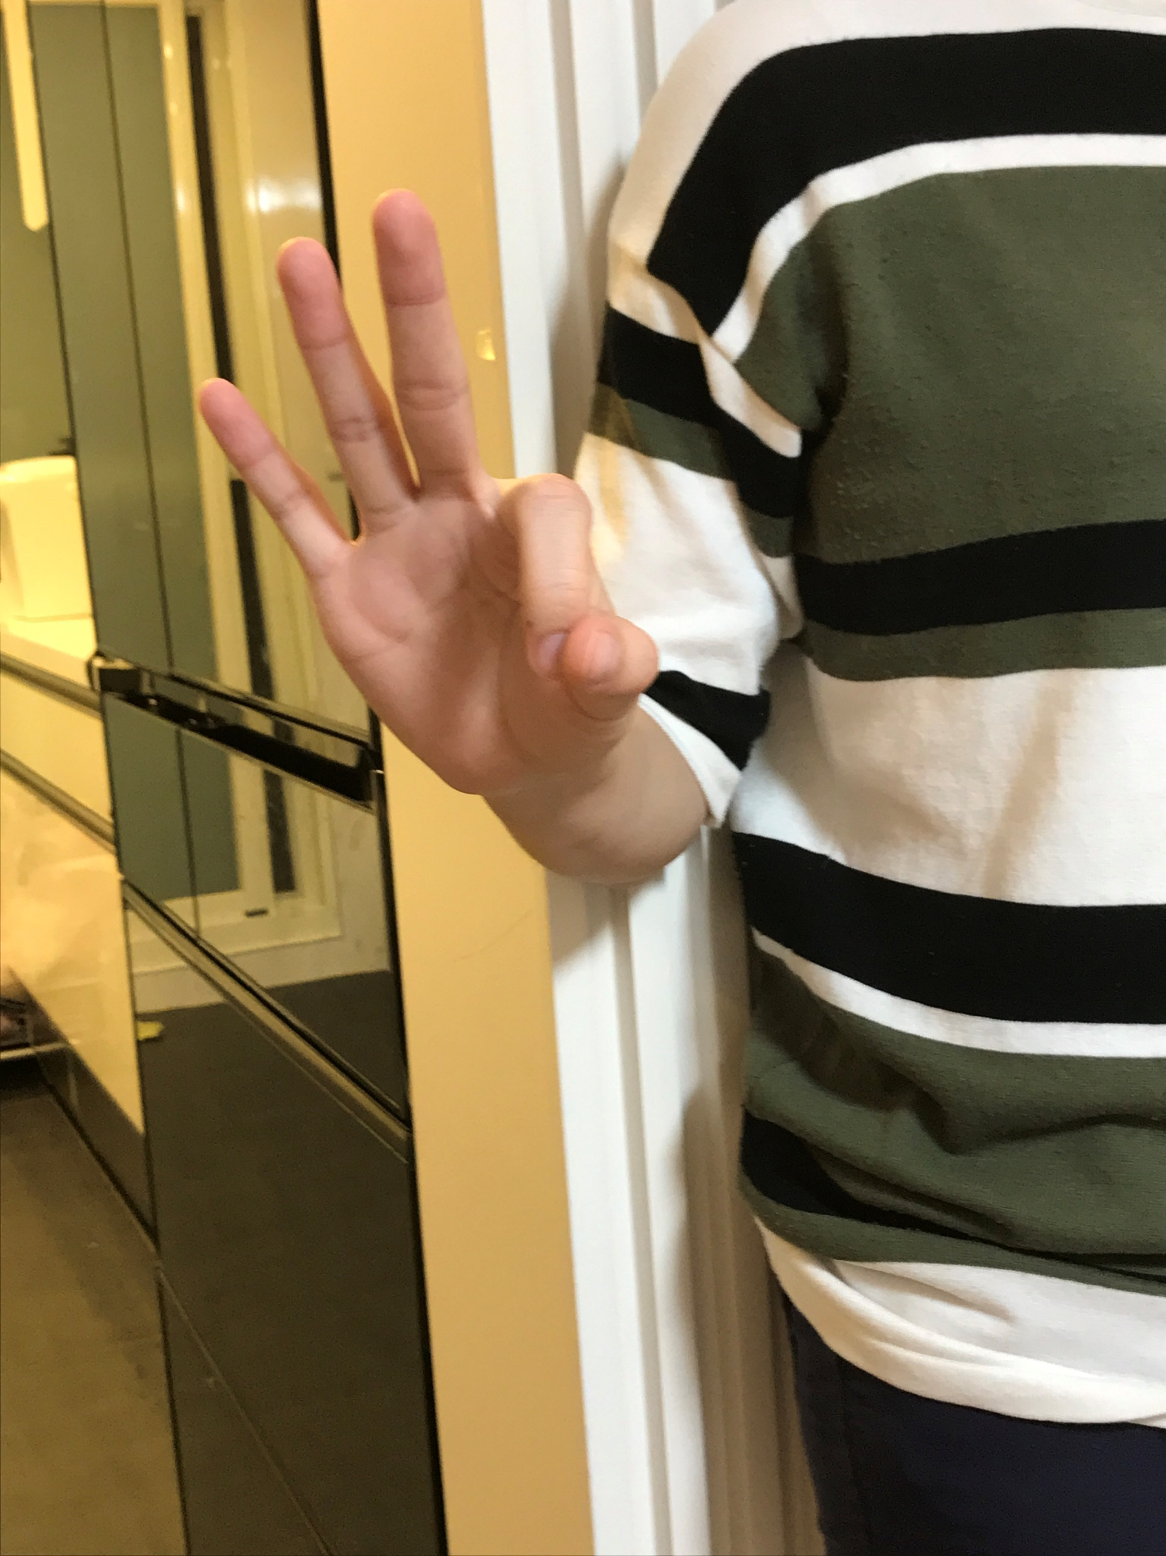
dataset
0-9 手語影像各100張

Slide 7
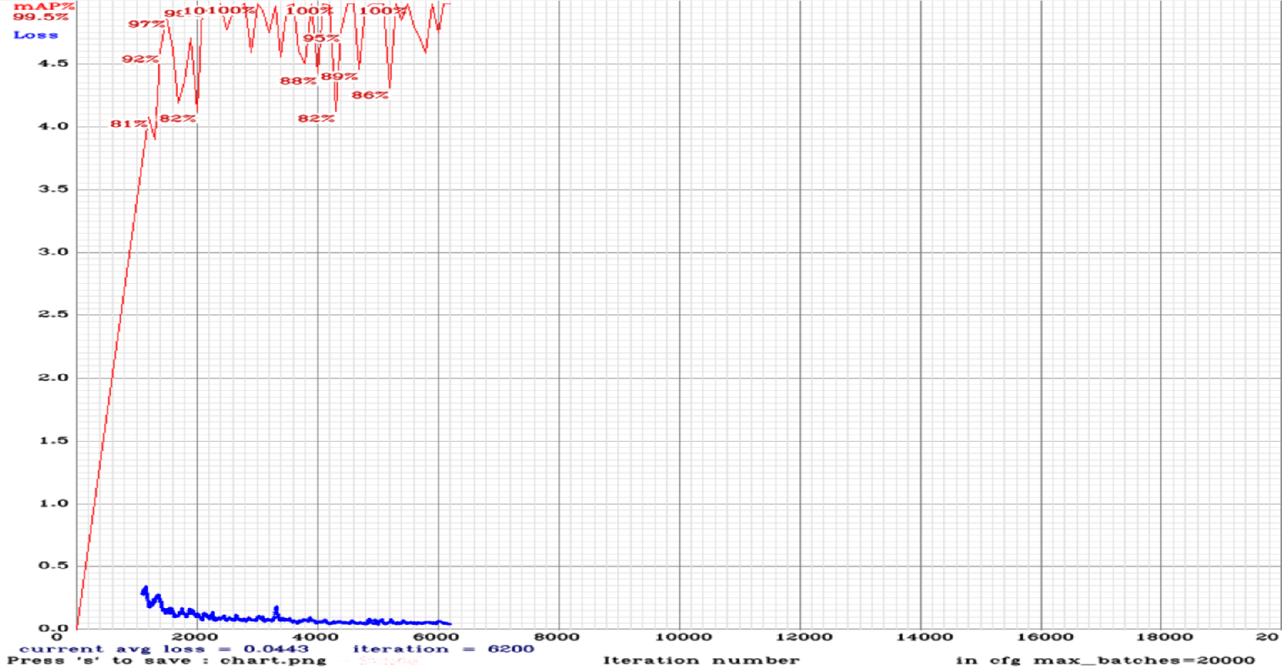
實驗結果

Slide 8
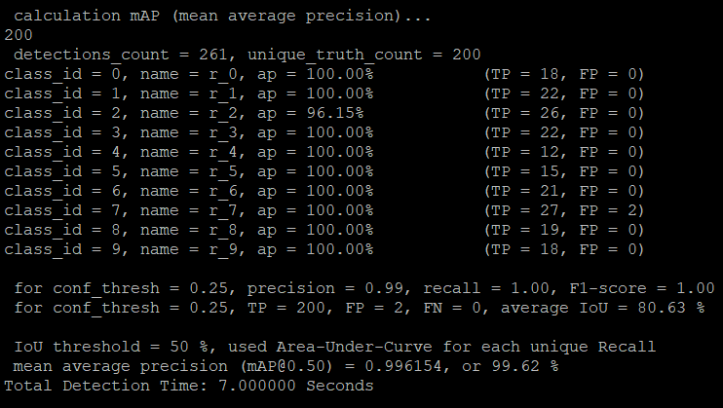

Slide 9
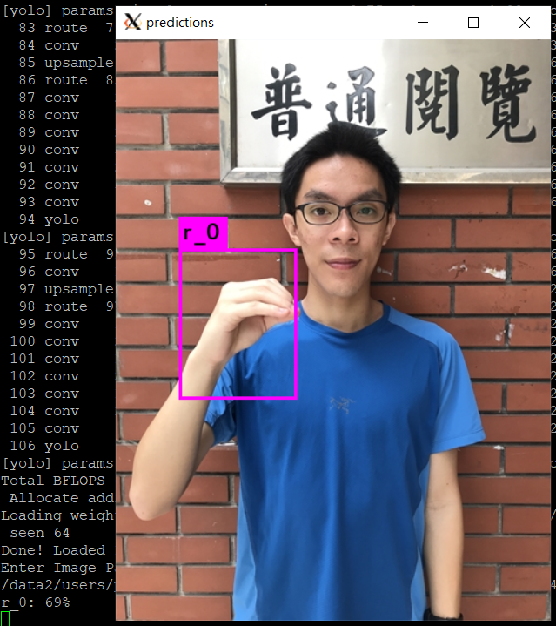
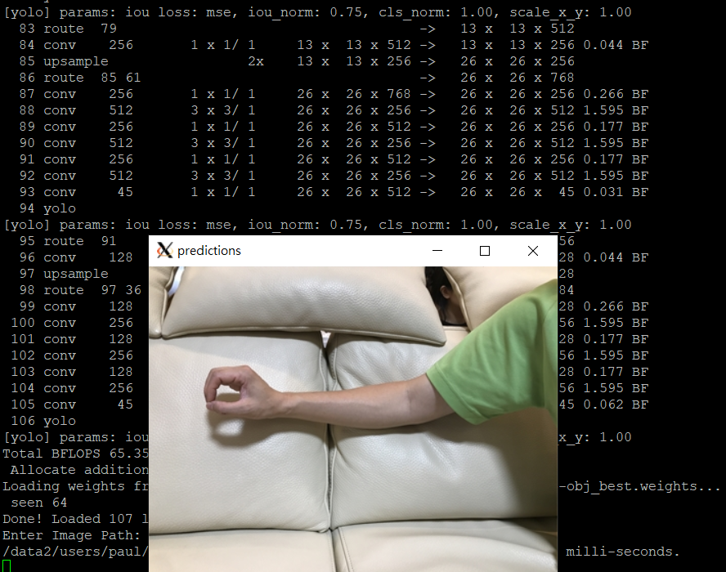

Slide 10
討論
訓練資料太少,可能造成 overfitting
MAP未收斂,訓練的iteration數不夠
只能偵測靜態圖片,無法偵測連續動作

Slide 11
LSTM(Long-Short Term Memory)

Slide 12
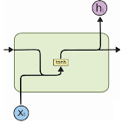
Recursive Neural Network (RNN)
Predict depending on the last state
Receive the last state as an input
Problem:
Vanishing gradient problem is greater

Slide 13
LSTM
Short term memory
Remember the last state
Long term memory
Can remember thing that are not in the las state
it​=σ(Wii​xt​+bii​+Whi​h(t−1)​+bhi​)
ft​=σ(Wif​xt​+bif​+Whf​h(t−1)​+bhf​)
gt​=tanh(Wig​xt​+big​+Whg​h(t−1)​+bhg​)
ot​=σ(Wio​xt​+bio​+Who​h(t−1)​+bho​)
ct​=ft​∗c(t−1)​+it​∗gt​ht​=ot​∗tanh(ct​)​

Slide 14
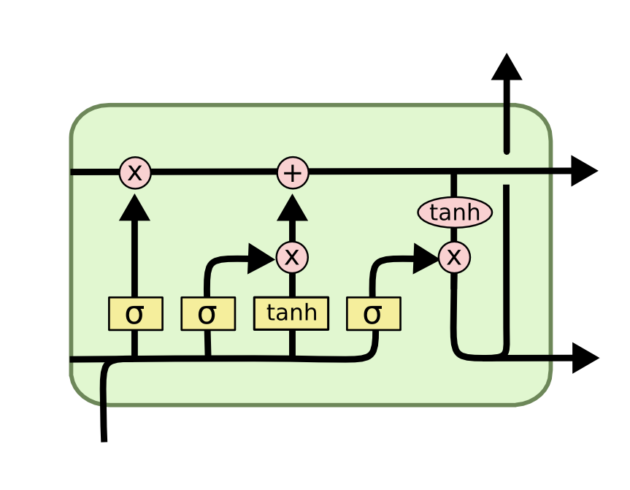
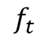
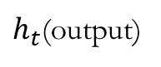
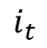
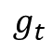
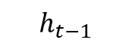
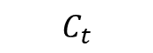
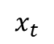
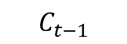
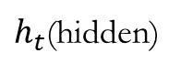
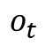
gates
Forget
$h_{t}$(output)
Output
Forget things that are not necessary
$$C_{t}$$
The prediction base on the input the past state
$$C_{t−1}$$
$$f_{t}$$
$$i_{t}$$
$$o_{t}$$
$$g_{t}$$
$$h_{t−1}$$
$h_{t}$(hidden)
$$x_{t}$$
Input
Cell estate
Is an internal memory, use to remember things

Slide 15
Video
Frame 1
Frame 2
…
Frame n
CNNx6
CNNx6
CNNx6
flatten
flatten
flatten
LSTM
LSTM
LSTM
…
My model
linear
linear
linear
prediction

Slide 16
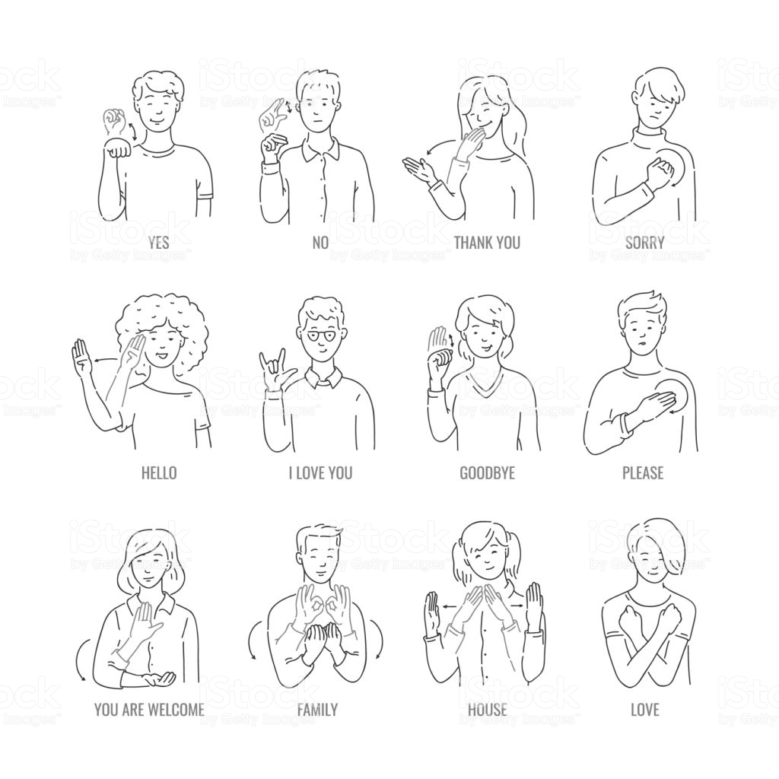
Why ?
To predict base on a sequence of movement

Slide 17
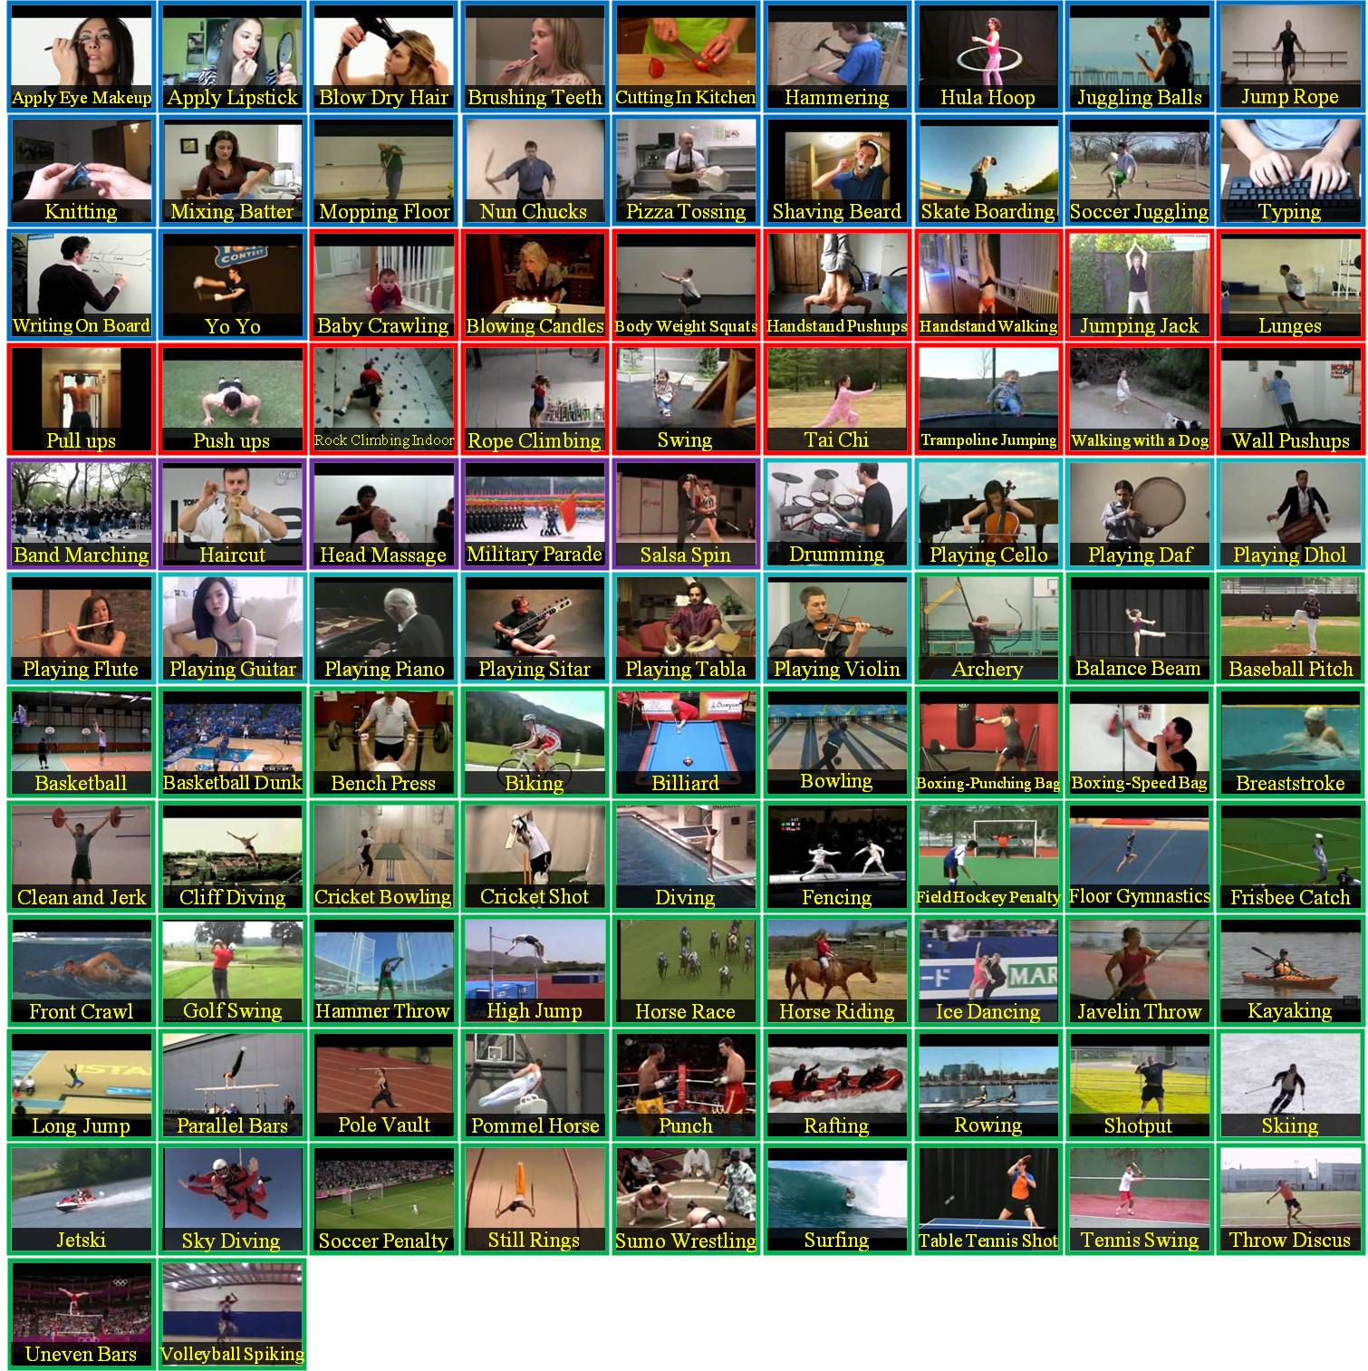
Data
Due to the lack data, we first try to train with UCF101

Slide 18
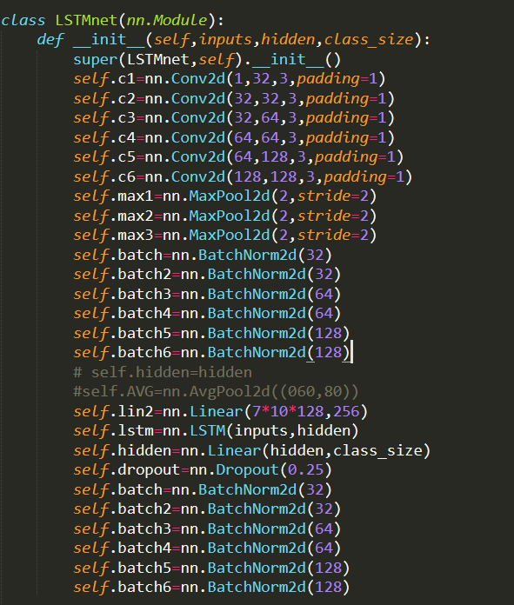
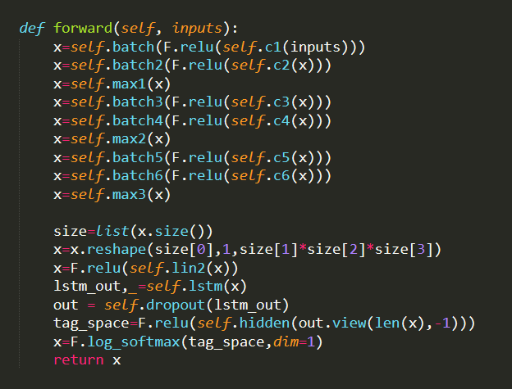
用整個影片產生一個Prediction之accuracy : 7.444%
每10個frame產生一個Prediction之accuracy :29.6%

Slide 19
未來規劃

Slide 20
未來規劃
寒假:
收集動態手語資料(10種)
訓練C3D模型
閱讀C3D、I3D相關論文

Slide 21
END

